Slide 1
Sampling design

Slide 2


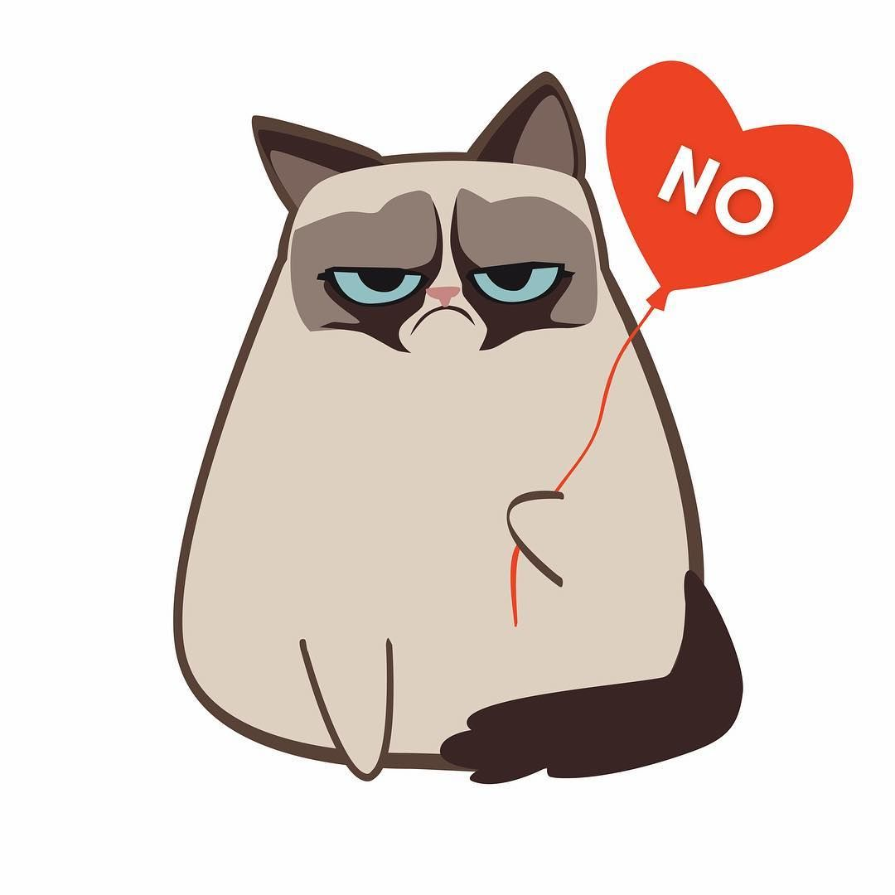
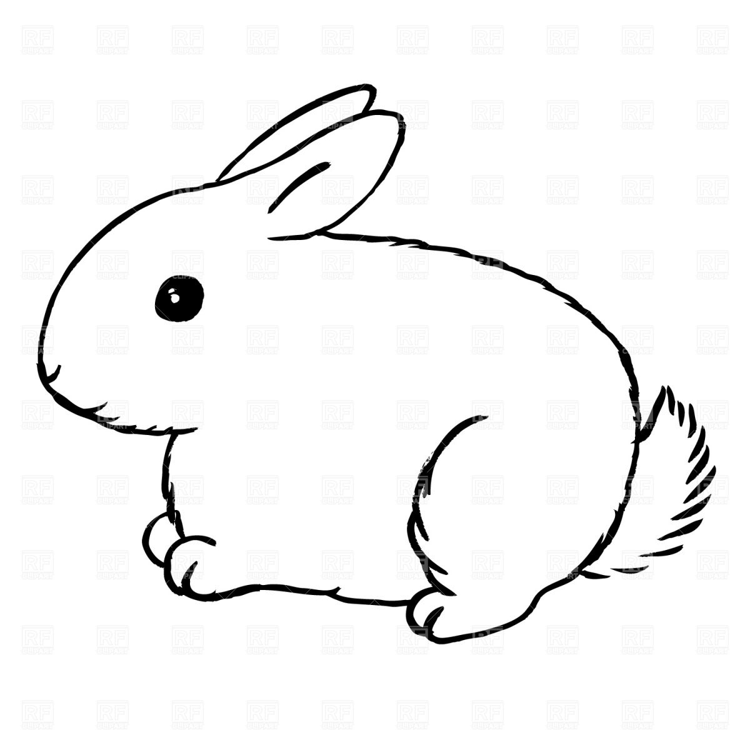
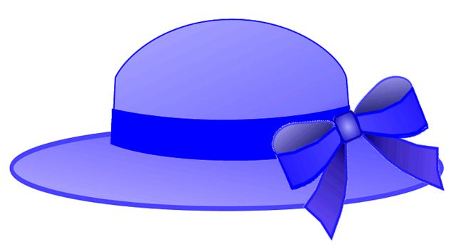
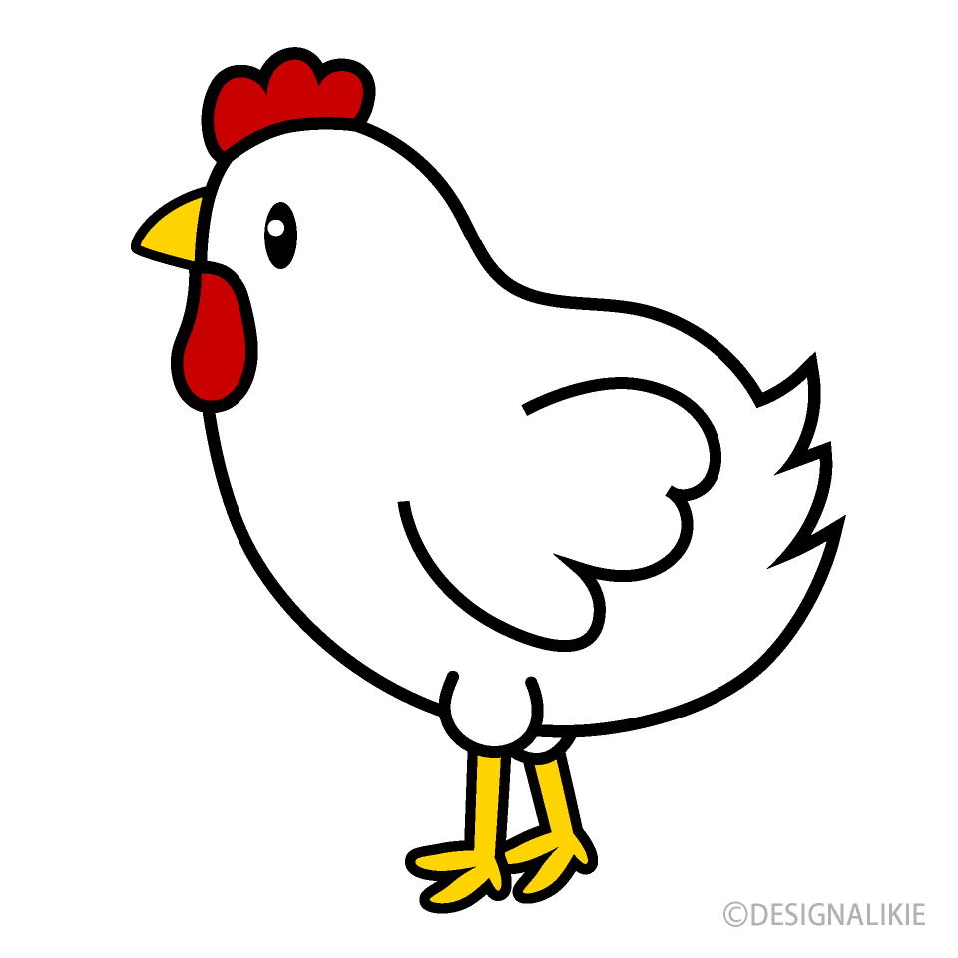
7
3
1
2
6
5
4
8
Notes:
Our goal – Determine what is under the hats.
1. If we lift up the top hat, and find a rabbit, what do we know?

Slide 3
What do we know?
1. Top hats contain rabbits.
2. Hats contain rabbits.
3. One top hat contained a rabbit today.

Slide 4
7
3
1
2
6
5
4
8
Notes:
Our goal – Determine what is under the hats.
Let’s take a larger sample size. We need at least three samples to get some idea of the variation in a population

Slide 5
Now what do we know?
1. Top hats contain rabbits.
2. Hats contain rabbits.
3. At least 50% of top hats contain rabbits today, one red fedora contained a grumpy cat today.

Slide 6
Notes:
Our goal – Determine what is under the hats.
1. If we lift up the top hat, and find a rabbit, what do we know?

Slide 7
Now what do we know?
1. Most top hats contained rabbits today
2. Fedoras probably contain grumpy cats today.
3. One purple hat contained a chicken today.

Slide 8
The trade-off:
More samples = more power
More samples = more work

Slide 9
Replication
Reduces the effect of noise
Increases precision
Supplies an estimate of error/variability.

Slide 10

Why random?
Notes:
So, if we sample one point repeatedly, we know a lot about that point. In this case, that one hat always has a grumpy cat under it. But we don’t know anything about any of the other hats, even though they look the same.
If we randomly select four hats (instead of sampling one hat four times) we can now be pretty confident in saying that red hats contain grumpy cats, at least right now.
BUT! If we want to know something about red hats over a long period of time, we need to randomly sample several hats at several time points.
If you have multiple types of hats, you’d want to stratify randomly.

Slide 11
Why random?
Fixed samples increase your power to know exactly what is going on in one particular place.
Random samples allow you to generalize to similar places.
Notes:
So, if we sample one point repeatedly, we know a lot about that point. In this case, that one hat always has a grumpy cat under it. But we don’t know anything about any of the other hats, even though they look the same.
If we randomly select four hats (instead of sampling one hat four times) we can now be pretty confident in saying that red hats contain grumpy cats, at least right now.
BUT! If we want to know something about red hats over a long period of time, we need to randomly sample several hats at several time points.
If you have multiple types of hats, you’d want to stratify randomly.
Randomization also reduces experimentor bias. NOTE: There is a difference between “haphazard” and “radom”. It’s hard to be truly random without a machine generating your random points for you.

Slide 12
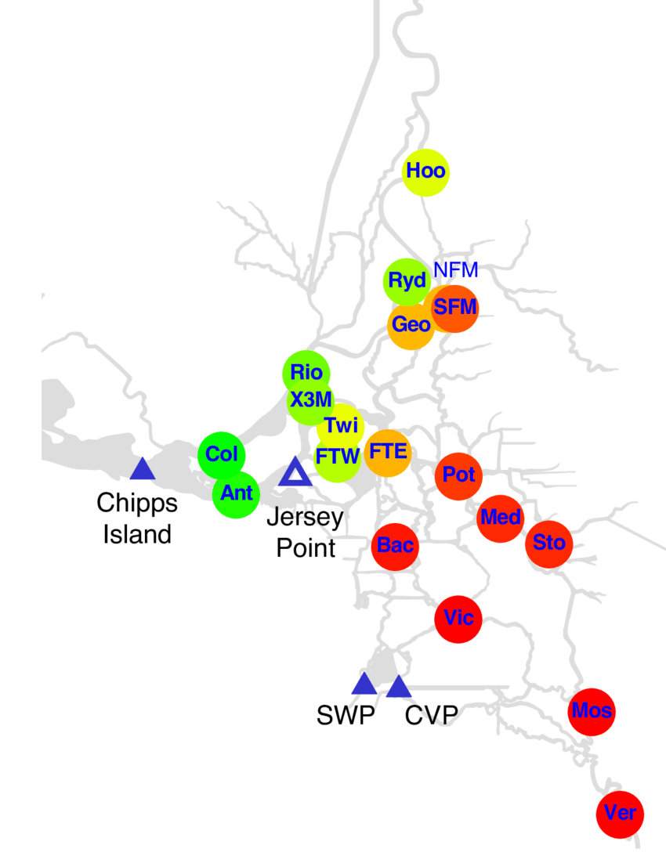
Why not random?
Sometimes you really want to know about a particular place!
Notes:
Example: Chipps island trawl. Your question is about the timing of fish moving through, not the spatial distribution of fish, so it’s more important to have thorough temporal coverage in one spot than thorough spatial coverage.
This is a map of salmon release sites. They all need to move through Chipps island, so we’ll just sample there.
Now- how frequently to sample? Should we use random times? Probably, but that’s where feasibility comes in.

Slide 13
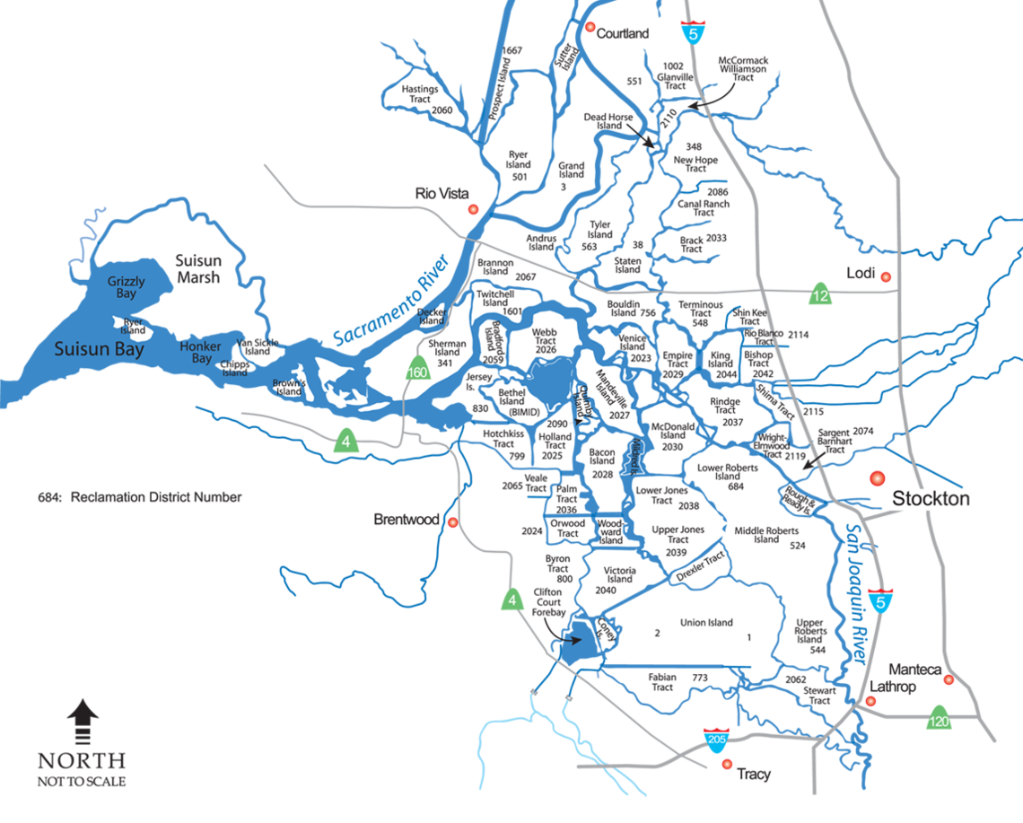
Space versus time
I can only take 20 samples this summer. How should I do it?
1. Five samples four times
2. Twenty samples once
Notes:
Discuss!
Answer: Trick question – it depends on what you are trying to measure.

Slide 14
For each question, is spatial or temporal replication more important?
What is the coverage of aquatic weeds in the Delta?
When is the peak of the splittail spawning season?
Where do Delta Smelt spawn?
Which salmon migration corridor has highest survival?

Slide 15
Pseudoreplication
Most models for statistical inference require true replication. True replication permits the estimation of variability within a treatment.
True replicate, is the smallest experimental unit to which a treatment is independently applied.
Pseudoreplicates are “replicates” that are not independent
Notes:
Pseudoreplication
The harest part is determining your experimental unit.
The term pseudoreplication was coined by Hurlbert to refer to "the use of inferential statistics to test for treatment effects with data from experiments where either treatments are not replicated (though samples may be) or replicates are not statistically independent."¹ The context of his paper was ecological field experiments, but pseudoreplication can occur in other contexts as well. Here, replication² refers to having more than one experimental (or observational) unit with the same treatment. Each unit with the same treatment is called a replicate. Heffner et al³ distinguish a pseudoreplicate from a true replicate, which they characterize as "the smallest experimental unit to which a treatment is independently applied." Most models for statistical inference require true replication. True replication permits the estimation of variability within a treatment. Without estimating variability within treatments, it is impossible to do statistical inference.
Most people have problems with pseudoreplication when they are confused about their experimental unit.

Slide 16
What’s the problem?
Increases the chance of “false positivies” (type-1 error)
Confidence intervals articificially small.

Slide 17

Example 1:
Question: What is the effect of pyritheroid pesticides on fish swimming?
3 treatments, 6 fish per treatment, each fish has its swimming speed tested 5 times.
What is my experimental unit?
How many replicates do I have?
How can I improve my design?
Control (no pestidcides)
Low pyrethroids
High pyrethroids
Notes:
Ideally these fish would not have one tank per treatment.
Multiple tests per fish allows you to characterize your within-subject variability, but your within-treatment (between-subject) variability is what you will need for your statistical model so we can compare treatments.

Slide 18
Example 2:
Question: What type of habitat has the most zooplankton?
4 samples each month for 6 months
4 samples per month for 6 months
What is my experimental unit?
How many replicates do I have?
How can I improve my design?
4 samples each month for 6 months
Grizzly Bay
(shallow bay)
Rio Vista
(Channel)
Frank’s Tract
(flooded island)
Notes:
GB – mean = 20, sd = 5
RV – mean = 10, sd = 5,
FT = mean = 25, sd = 5
How would our experimental unit change if our question changed?

Slide 19
Example 2:
Question: What type of habitat has the most zooplankton?
Shallow Bays
Channel
Flooded Island
1 sample/month 6 months
1 sample /month 6 months
1 sample/ month 6 months
Suisun Bay
Frank’s Tract
Now how many replicates do I have?
Are the monthly samples pseudorepliacates? Does that make them bad?
Rio Vista
1 sample/month 6 months
1 sample /month 6 months
1 sample/ month 6 months
San Pablo Bay
Antioch
Liberty Island
1 sample/month 6 months
1 sample /month 6 months
1 sample/ month 6 months
Honker Bay
San Joaquin
Mildred Island
1 sample/month 6 months
1 sample /month 6 months
1 sample/ month 6 months
Grizzly Bay
Steamboat Slough
Big Break
Notes:
If this is all during one year, do we have a problem?
We can’t do everything, everywhere!!

Slide 20
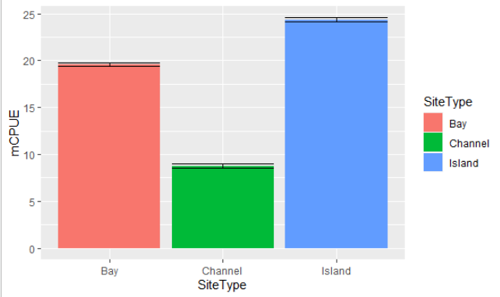
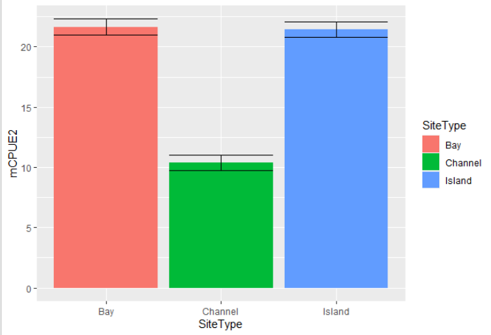
Design 1
Design 2

Slide 21
Dealing with non-independence
Mixed models!
Response ~ Predictor + Error(Experimental Unit)
Notes:
Not all “pseudoreplication” is bad. Sometimes you want to increase your replication within an experimental unit in oder to reduce the overall variation within the treatment without increasing the nubmer of experimental units. This is particularly important if you have both spatial and temporal variation to deal with. Fortunately, we’ve got models for that.
Go to R code, if time allows.

Slide 22
Hurlburt v. Oksanen
Can we use statistics in experiments without true replicates?
How can we avoid falling into the pseudoreplication trap?
Of Oksanen’s four experiment options, which do you think is the most useful?
Has demonic intrusion ever impacted your experimental results?
Notes:
Microcosms
Focus on transient dynamics and individual behavior
Single treatment replicated controls
A. unreplicated experiment, nostats, B. unreplicated experiment, stats + caveats.

Slide 23
Example – Larval entrainment
How many smelt get entrained into Clifton Court Forbay?
When do larval smelt entrainment events occur? (timing and duration)
What environmental conditions can be used to predict larval entrainment events?

Slide 24
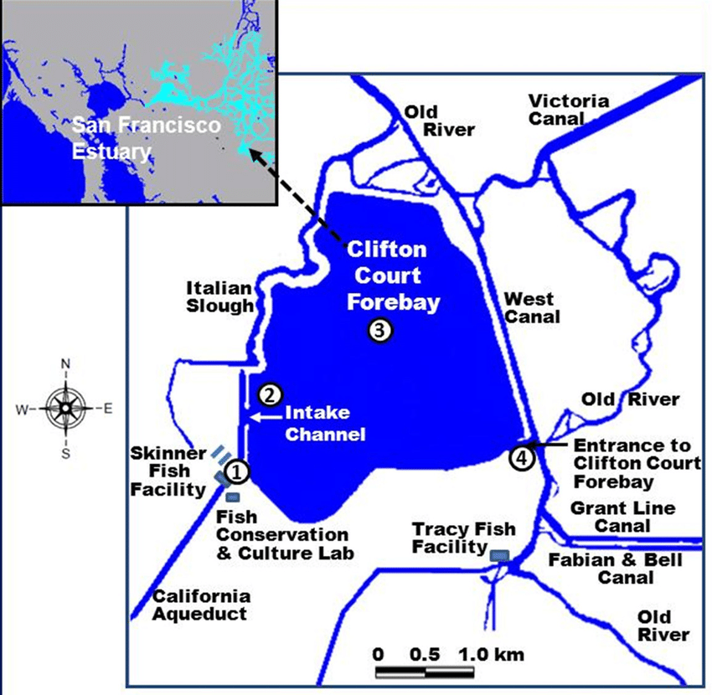

Slide 25
Your tools
Larval trawl
Gives you catch/volume
3 people per trawl
6 person-hours per sample
Analysis cost $100
EDNA
Presence/absence only
1 person per sample
1 person-hours per sample
Analysis cost: $7.50

Slide 26
Question: How many smelt get entrained into Clifton Court Forbay?
What kind of sample will you use?
Where will you sample?
When will you sample?
How many replicates per sampling event?
Notes:
Introduce the idea of power analysis
Where will yo usample – highlight random versus fixed stations, stratified versus not. Are there any obstructions or logistical issues to be aware of?
When will you sample? – Ask about time of day, tide stage, frequency, time of year.

Slide 27
Question: When do larval smelt entrainment events occur? (timing and duration)
What kind of sample will you use?
Where will you sample?
When will you sample?
How many replicates per sampling event?
Notes:
How will you approach this questions differentlyu?
Introduce the idea of power analysis
Where will yo usample – highlight random versus fixed stations, stratified versus not. Are there any obstructions or logistical issues to be aware of?
When will you sample? – Ask about time of day, tide stage, frequency, time of year.

Slide 28
Question: What environmental conditions can be used to predict larval entrainment events?
What kind of sample will you use?
Where will you sample?
When will you sample?
How many replicates per sampling event?
Notes:
How will you approach this questions differentlyu?
Introduce the idea of power analysis
Where will yo usample – highlight random versus fixed stations, stratified versus not. Are there any obstructions or logistical issues to be aware of?
When will you sample? – Ask about time of day, tide stage, frequency, time of year.
Here we need to think about more than just smelt sampling, we also need to sample environmental conditions. Use existing data collection where possible.

